Slide 1

Financial Management
in the
Healthcare Industry
Week III
HCM 302

Slide 2
Week III Outline
-Group Project
-Production Reports
-Physician Employment
-Physician Contract
-HC Youtube
-Practice Exam

Slide 3
Group Project
02/02/2012
HCM 302

Slide 4
Week III and IV
1) Physician recruitment
2) Hiring of other office staff – LPNs/medical assistant/accountants/receptionist
3) Sample contracts for physicians
4) Contracts with hospitals
5) Hospital privileges
6) Contract with office space (rent/buy)
7) Insurance Credentialing
8) NPI numbers
9) Fee schedule – about 10 CPT codes
10) Schedule for physicians
11) Plan for how to grow patient base/how to receive more patients from local PCPs
  Uninsured/unassigned/PCPs
  PCPs in Southern Delaware that still do not utilize hospitalists to the extent of Christiana area
12) Mission statement
13) Hire a lawyer
14) Cell phones/pagers for physicians
15) Retention strategy
16) Flow charts for structure of organization
17) Use specific dates for process; especially with hospital privileges and/or credentialing
18) Immigration/J1 waiver application if applies
19) Website

Slide 5
Group A
1- Dana
3- Deja
2-Theresa
        4- Nancy
Medical Practice Name: Women’s Specialty Care
Details :
Specialty: OB-GYN
# Of Employees: 10
# Of Physicians: 6
# Of PA's :2
# Of MW‘s: 2
# Of Offices: 3
# Org Type: C-Corp

Slide 6
Group B
1- Diana
3- Hana
2- Devon
        4- Cailin
Medical Practice Name: Community Care of New Castle County
Details :
Specialty: Family Medicine
# Of Employees: 14
# Of Physicians: 9
# Of PA's :3
# Of NP‘s: 3
# Of Offices: 2
# Org Type: LLC

Slide 7
Group A
1- Natalia
3- Irene
2-Norberto
        4- Alyssa
Medical Practice Name: Pediatric Physician Care
Details :
Specialty: Pediatric
# Of Employees: 10
# Of Physicians: 6
# Of PA's :2
# Of MW‘s: 2
# Of Offices: 3
# Org Type: C-Corp

Slide 8
Productivity Reports
02/02/2012
HCM 302

Slide 9
Vitals Signs
Service Date
 | YTD 8/31/2009 | YTD 8/31/2010 | Change + - | Change %
New Patients | 437 | 422 | -15 | -3.43%
Established Patients | 14584 | 15939 | 1355 | 9.29%
New Physicals | 160 | 99 | -61 | -38.13%
Established Physicals | 982 | 759 | -223 | -22.71%
Home Visits | 1537 | 1116 | -421 | -27.39%
New Rest Home Vistis | 14 | 18 | 4 | 28.57%
Est Rest Home Vists | 711 | 949 | 238 | 33.47%
New Nursing Home | 206 | 204 | -2 | -0.97%
Established Nursing Home | 1858 | 2589 | 731 | 39.34%
Initial Hospital Visits | 479 | 551 | 72 | 15.03%
Subsequent Hospital Visits | 2667 | 2745 | 78 | 2.92%
Con IP | 73 | 6 | -67 | -91.78%
Con OP | 177 | 101 | -76 | -42.94%
Charges | $4,159,916.76 | $4,374,550.76 | $214,634.00 | 5.16%
Payments | $2,410,445.63 | $2,535,378.74 | $124,933.11 | 5.18%

Slide 10
CHARGES
 | Jan-09 | Feb-09 | Mar-09 | Apr-09 | May-09 | Jun-09 | Jul-09 | Aug-09 | Sep-09 | Oct-09 | Nov-09 | Dec-09
Dr 1 | 183,149.00 | 185,606.51 | 185,621.79 | 197,132.00 | 165,398.00 | 178,834.00 | 167,711.57 | 180,926.00 | 196,810.00 | 176,104.00 | 191,416.00 | 138,754.00
Dr. 2 | 95,044.00 | 92,600.00 | 86,523.00 | 94,054.00 | 82,283.00 | 103,359.00 | 90,444.00 | 79,663.49 | 87,724.96 | 97,438.00 | 87,376.00 | 72,757.00
Dr. 3 | 35,251.50 | 39,856.00 | 43,282.78 | 31,739.00 | 35,133.00 | 37,435.00 | 16,763.00 | 40,489.00 | 37,097.00 | 32,945.00 | 54,416.00 | 26,468.00
Dr. 4 | 49,552.00 | 47,906.50 | 30,134.00 | 35,728.58 | 41,110.00 | 65,799.00 | 27,804.00 | 38,433.07 | 58,060.00 | 49,995.48 | 52,648.21 | 34,015.50
 | 362,996.50 | 365,969.01 | 345,561.57 | 358,653.58 | 323,924.00 | 385,427.00 | 302,722.57 | 339,511.56 | 379,691.96 | 356,482.48 | 385,856.21 | 271,994.50
CHARGES | Jan-10 | Feb-10 | Mar-10 | Apr-10 | May-10 | Jun-10 | Jul-10
 | 201,459.00 | 168,357.04 | 195,438.59 | 156,251.00 | 148,633.01 | 166,337.60 | 178,895.00
Dr 1 | 100,033.00 | 94,349.00 | 97,667.00 | 91,674.00 | 79,037.00 | 112,439.00 | 92,221.00
Dr. 2 | 41,708.43 | 44,524.00 | 35,057.00 | 32,447.00 | 23,142.26 | 51,183.00 | 37,802.00
Dr. 3 | 39,748.53 | 27,258.47 | 59,031.50 | 47,337.44 | 53,786.96 | 54,016.00 | 46,048.60
Dr. 4 | 0.00 | 22,605.00 | 36,010.00 | 32,106.44 | 47,719.00 | 50,624.00 | 38,751.00
 | 382,948.96 | 357,093.51 | 423,204.09 | 359,815.88 | 352,318.23 | 434,599.60 | 393,717.60

Slide 11
Month | Practice Management System | Accounting System | Difference
November-09 | $ 302,913.34 | $ 288,952.15 | $ 13,961.19
December-09 | $ 333,621.14 | $ 322,062.92 | $ 11,558.22
January-10 | $ 218,306.21 | $ 232,680.63 | $ (14,374.42)
February-10 | $ 280,912.40 | $ 295,597.61 | $ (14,685.21)
March-10 | $ 322,844.06 | $ 331,285.78 | $ (8,441.72)
April-10 | $ 335,145.42 | $ 342,283.99 | $ (7,138.57)
May-10 | $ 294,694.11 | $ 299,043.25 | $ (4,349.14)
TOTAL | $ 2,088,436.68 | $ 2,111,906.33 | $ (23,469.65)

Slide 12
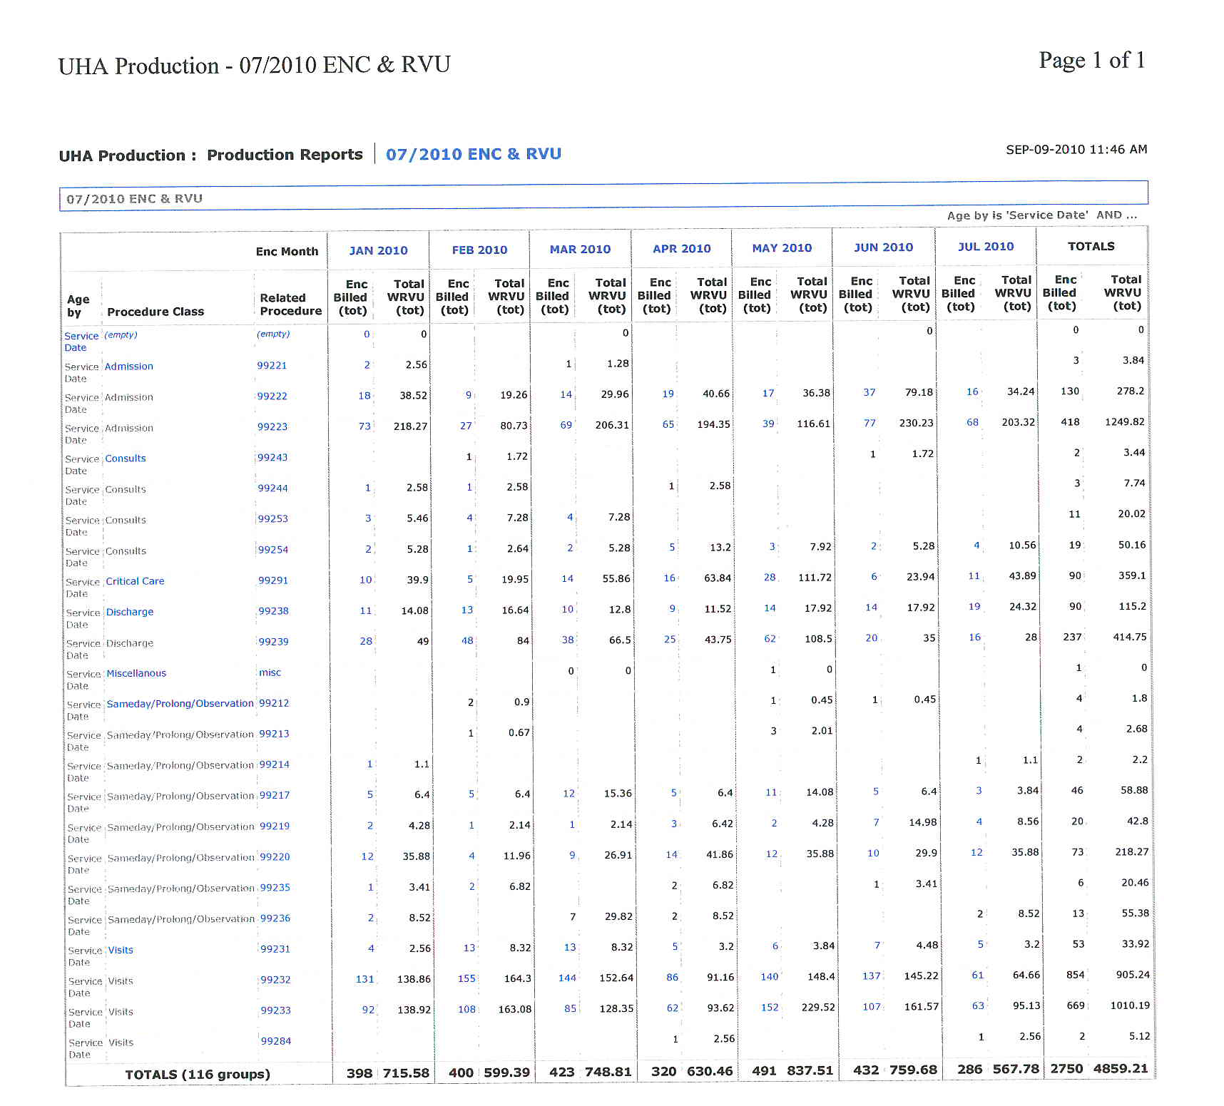
Practice Name

Slide 13
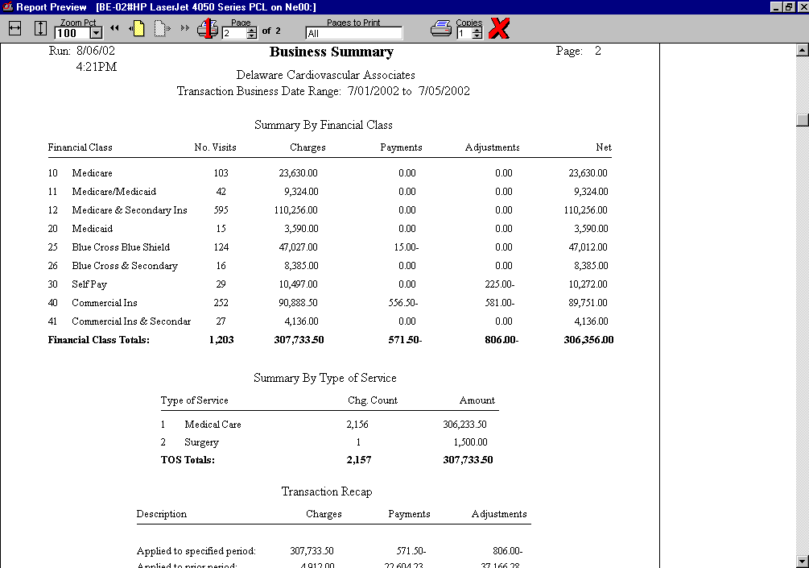

Slide 14
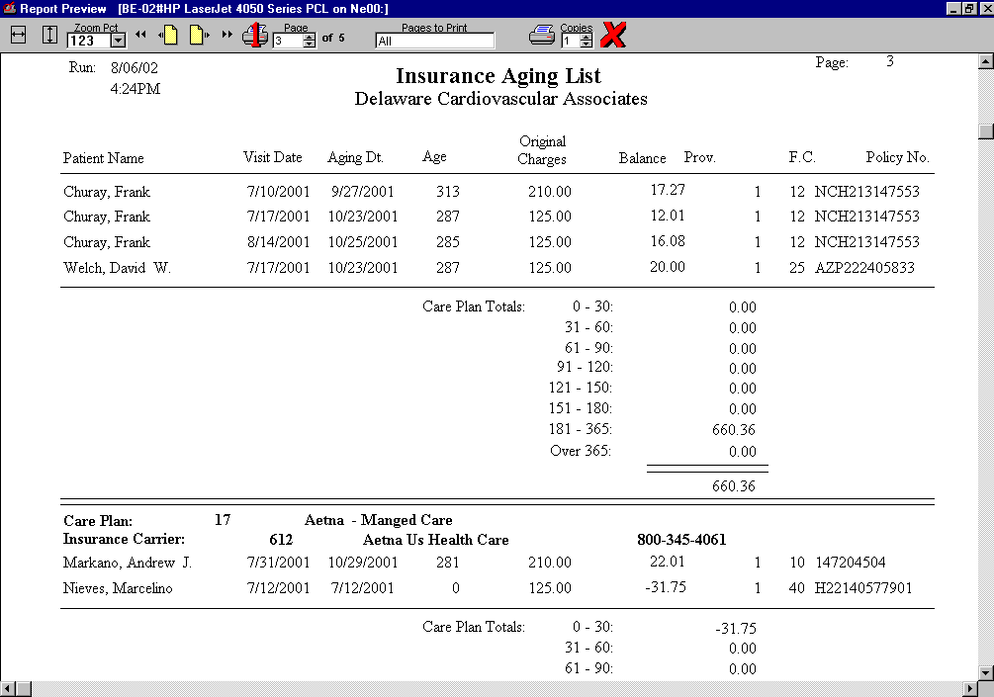

Slide 15
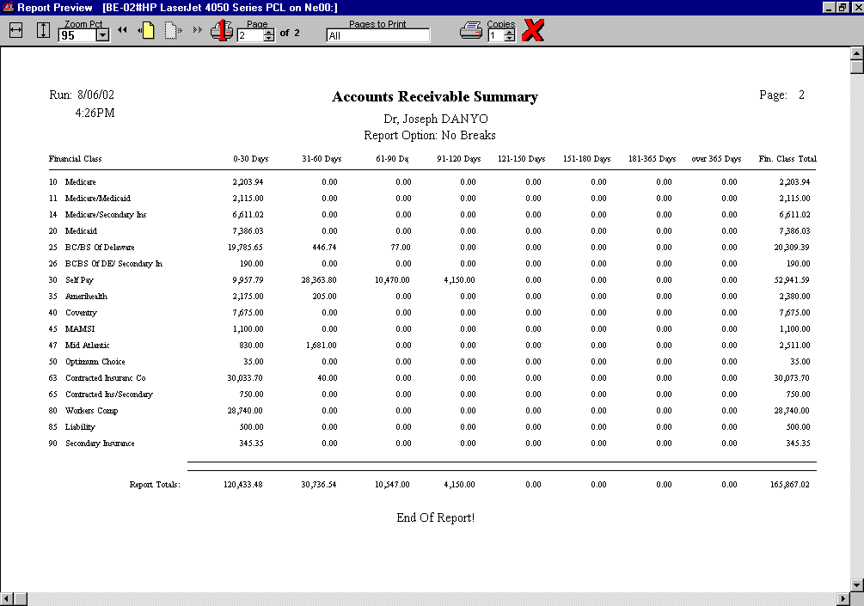

Slide 16
Turnaround Time For Correction
Less Than 3 Days (for All)
Medicare
Blue Cross
Coventry
Turnaround Time For Payment
4 to 10 Days

Slide 17
RETURN ON INVESTMENT SUMMARY

Slide 18
PAPER VERSUS EMR
EMR = With Standardized Coding X Efficiency
Paper = Prior to EMR
Differential = EMR - Paper

Slide 19
Physician Employments
Hospital Vs Private
02/02/2012
HCM 302

Slide 20
Conflict
-Most employment relationships involve at least some “give and take”
-With physician employment on the rise the line between medical staff rights and hospital employment obligations is becoming increasingly blurred.
-Important to conduct your due diligence before getting hired .
-In a perfect setting patient care should not be tied up in employment.
-Physicians have the right to treat patients unfettered from outside pressures.
-Physicians have obligations to serve their patients best interests.

Slide 21
Medical Staff Vs Employment
Medical staff membership and employment are indeed two separate roles.
Many hired physicians tend to overlook that the former often is a condition of the latter.
So losing privileges could mean losing a job.
Conversely, losing or leaving a hospital job often means that doctors will have to leave behind a medical staff membership.
Experts caution that when an employee leaves a hospital employment it is not uncommon for hospital contracts to break bylaws that protect staff membership and clinical privileges.

Slide 22
Hospital Vs Physicians
Hospitals do share an interest in fairness
Hospitals must balance patient care and liability concerns.
Hospitals do not want to go through elaborate hearing processes that can take months before enforcing the ability to fire someone.
If quality or safety issues arise and the doctor leaves or is terminated hospitals must be able to replace the doctor for continuity of care.

Slide 23
Reporting Incidents
If an incident is reportable to the National Practitioner Data Bank or the State Medical Board it will allow the full peer review process to take its course.
If nothing reportable is involved, an informal meeting with follow-up between the physician employee and a hospital administrator will suffice.

Slide 24
Preserving Privileges After Termination
What if the employed physician's departure is not reportable?
Involuntarily losing hospital privileges present issues...
They may need to reveal on future employment, licensing, and credentialing applications.
Report to Medical Liability Insurance Carriers.
What if a Non-Compete Exists....
Physicians Should ask Three Questions....
1- How do I get out?
2- What are my rights?
3- And what happens afterwards?

Slide 25
Physician Contracts
02/02/2012
HCM 302

Slide 26
Efficiency
Early 1900’s - technology advanced so cutting ice was very efficient
Refrigerator was invented
No need for tools and technology for ice cutting, no matter how efficient, because outdated by new technology

