Slide 1

Medicare Shared Savings Program
Presented by
John Donnelly
For Kemal Erkan
HCM-401 Course

Slide 2
Healthcare Reform & the Transformation of Reimbursements
Payments will be increasingly linked to performance
“Performance risk” will be increasingly transitioned to providers
Payers and consumers will become accountable; and a greater value will be placed on maintaining individual health

Slide 3
Accountable Care Organizations
ACOs are groups of doctors, hospitals, and other health care providers, who come together voluntarily to give coordinated high quality care to the patients they serve
When an ACO succeeds in both delivering high-quality care and spending health care dollars more wisely, it will have the opportunity to share in the savings it achieves

Slide 4
Medicare Shared Savings Program
The Affordable Care Act, signed by President Obama in March of 2010, requires CMS to establish a shared savings program in order to:
    Facilitate coordination and cooperation among providers
    Improve quality of care
    Reduce unnecessary costs

Slide 5
Medicare Shared Savings Program
The Shared Savings Program is designed to improve outcomes & increase value of care by:
    Promoting accountability for the care of Medicare FFS beneficiaries
    Requiring coordinated care for all services provided under Medicare FFS
    Encouraging investment in infrastructure and redesigned care processes

Slide 6
Requirements
Form a legal structure to receive and distribute shared savings to participating providers
3-year agreement
Have a minimum of 5,000 Medicare beneficiaries
Report Quality Measures

Slide 7
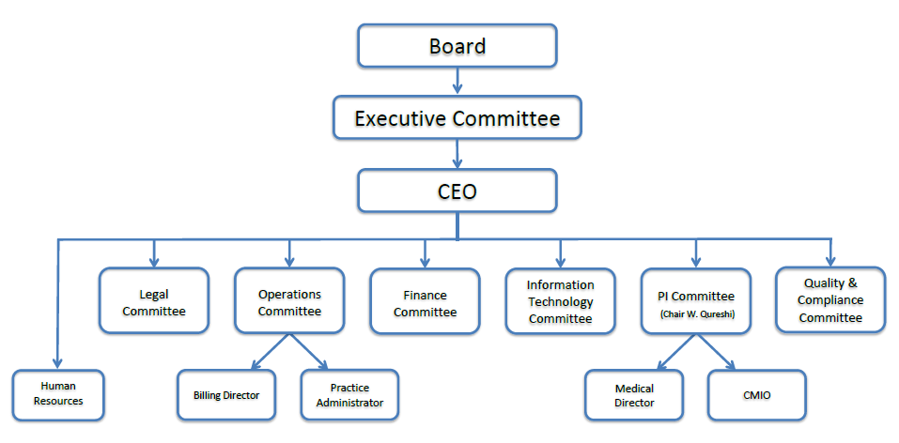
United Medical ACO Organizational Structure

Slide 8
Timeline
CMS will begin accepting applications for the Shared Savings Program on January 1st, 2012
First ACO agreements start on April 1st, 2012 and July 1st, 2012
  First performance year will be 18 or 21 months

Slide 9
Quality Measures
Quality Assessments will be calculated based on 33 measures from the following 4 domains;
  Patient Experience
  Care Coordination and Patient Safety
  Preventive Health
  Caring for at-risk populations

Slide 10
Payment Models
One-Sided Model
  Share up to 50% of any savings they achieve compared to target spending
Two-Sided Model
  Share up to 60% of the savings, but will also be accountable for losses

Slide 11
Issues
Upfront Expenses
  Final rule did create the “Advanced Payment Model” that provides upfront funds. This money would be recovered from any future shared savings achieved by the team of providers
Legal Issues
  Stark & Anti-Kickback
HHS estimates that ACOs could save Medicare up to $940 million in the first 4 years
  Far less than 1% of Medicare spending during that time period

Slide 12
Shared Savings Program
Questions?

